Slide 1

A Nomad Is Born
You rise before the sun. A single click closes the old life; one more opens the ticket that begins the new. The hill behind you is childhood, office walls, yesterday’s version of yourself. Ahead lies a sky so wide it seems to breathe. In your chest, wonder and nervous laughter mingle like first-morning mist.
Freedom always starts with leaving.

Slide 2

The Flight
Cities scroll beneath like pages in a favorite novel: Porto’s tiled rooftops, Nairobi’s afternoon rain, Kyoto at cherry-blossom dusk. You sip coffee on three continents in a single season and learn that belonging can be portable. Each border crossed is a paragraph in the autobiography you’re still writing.
Everywhere is foreign; therefore everywhere can be home.

Slide 3

The Storm
A scooter slips on Chiang Mai cobblestone. A fever blooms in Oaxaca night. Distance shrinks when you code, but stretches cruelly when you hurt. As lightning tears the sky you feel, viscerally; Tolstoy’s reminder: destiny is indifferent, yet character is forged in how we meet it.
Courage is not fearlessness; it is preparedness wrapped in hope.

Slide 4

The Net Revealed
Mid-fall, a gentle light unfurls, a net woven from thousands of unseen hands. It does not halt the storm, but it breaks the fall and steadies your heartbeat. This is SafetyWing: part promise, part community, wholly human. Your risk becomes our concern; your recovery, our shared triumph.
Interdependence is the highest form of freedom.

Slide 5

Rebirth of the Flock
Healed, you stretch new-strong wings. Slack pings with kind strangers offering clinic maps and hostel discounts; a newsletter tells how one nomad’s misfortune pooled into another’s miracle. The flock grows, not from marketing slogans but from stories whispered in co-working cafés: “They caught me; they’ll catch you.”
When trust compounds, fear dissolves and ambition doubles.

Slide 6
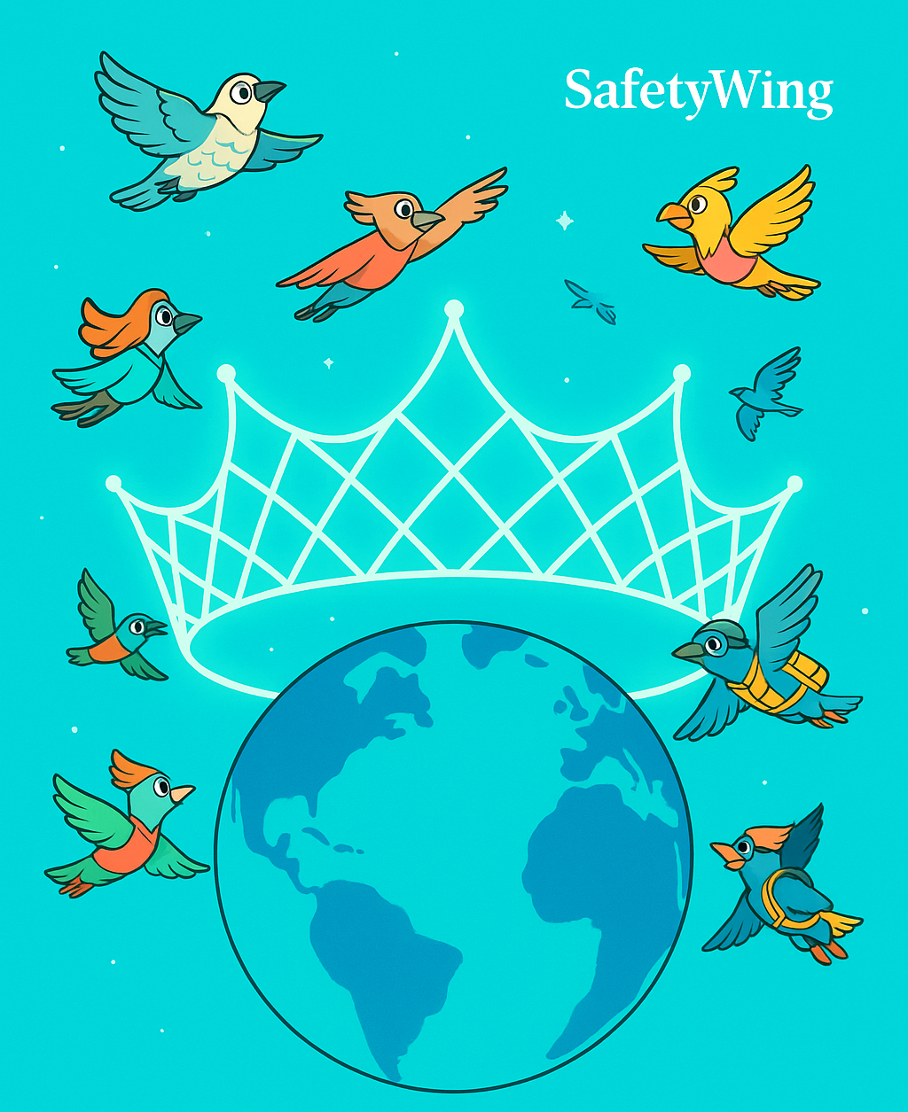
The Crowned Earth
Far above the spinning globe, the net glows like a crown that belongs to no monarch, only to the tribe in motion. You realise that SafetyWing has not entered insurance so much as invented Borderless Welfare, a quiet revolution stitched from empathy and code.
Keep flying. The sky is generous, and the net holds.

